Slide 1
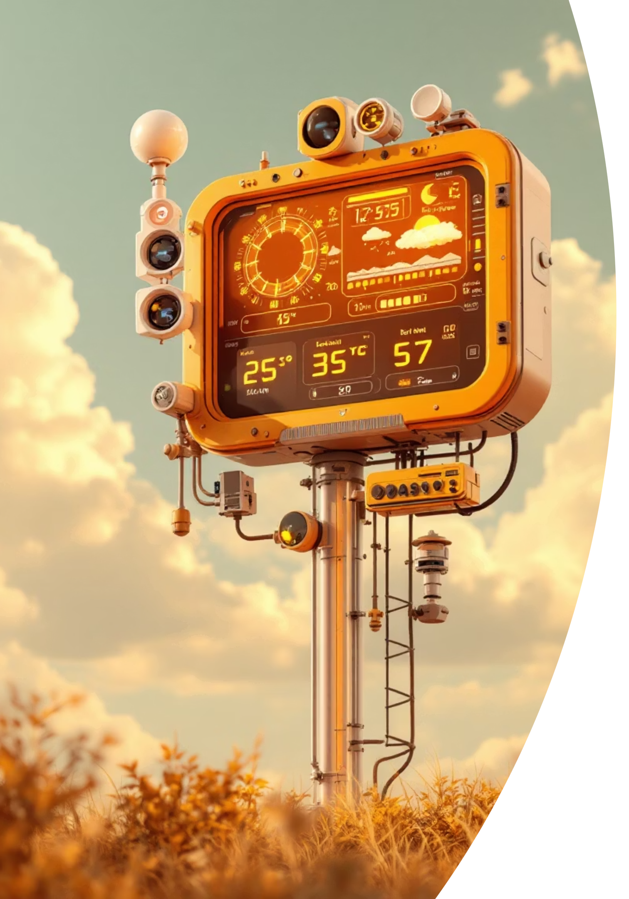
Smart Weather Station using IoT & Machine Learning
A data-driven approach to high-resolution environmental monitoring and predictive forecasting.

Slide 2
THE CHALLENGE
Why Smarter Forecasting is Critical
1
2
3
Traditional LimitationsManual instruments and sparse, fixed weather stations lead to data gaps and insufficient spatial coverage.
Climate VolatilityRapid climate changes and increasing frequency of extreme weather events necessitate quicker, more precise forecasting.
Impact on Key SectorsInaccurate forecasts severely affect agriculture, transportation logistics, and municipal disaster preparedness efforts.

Slide 3

System Abstract: Bridging the Data Gap
This system uses a dense network of IoT sensors to collect continuous, hyper-local environmental data (temperature, humidity, pressure, rainfall, wind speed).
The data feeds into Machine Learning models which analyze historical and real-time patterns to forecast weather with significantly higher accuracy than traditional methods. The result is a proactive dashboard providing predictive insights and real-time alerts for critical stakeholders.

Slide 4

OUR SOLUTION
Key Objectives of the Smart Weather Station
Continuous Monitoring
Accurate Prediction
Monitor environmental parameters 24/7 using energy-efficient IoT sensor nodes and securely upload data to cloud storage for historical analysis.
Apply sophisticated Machine Learning models to generate reliable short-term and long-term weather predictions.
Real-Time Visualization
Proactive Decision-Making
Provide an intuitive dashboard with real-time graphs, visualizations, and immediate alerts for developing weather events.
Support disaster management and urban planning by offering data-driven insights for proactive and timely intervention.

Slide 5

System Block Diagram: Data Flow Architecture
The system ensures a seamless flow of data from the physical environment to the final predictive insight, facilitating rapid response capabilities.
Alerts & Forecasts
Environmental Sensors
Notifications and visual forecasts
Temp, Humidity, Pressure, Rainfall, Wind
Dashboard
Data Flow Architecture
IoT Node
Visualization of results
ESP32 or Raspberry Pi
Machine Learning Model
Cloud Database
Firebase or Google Sheets
Predictive analytics and inference

Slide 6






Hardware Components: The Sensing Layer
Our hardware setup focuses on reliable, low-power components optimized for continuous data acquisition in varied environments.
Temperature & Humidity
Barometric Pressure
High-precision sensors (e.g., DS18B20 and DHT22) for ambient conditions.
BMP280 sensor monitors atmospheric pressure changes, crucial for predicting shifts in weather patterns.
Wind Speed & Direction
Rainfall
Anemometers provide inputs for real-time wind data, essential for tracking storms and wind power generation.
Specialized rain gauge sensors measure precipitation accumulation for flood risk assessment.
IoT Node
Power Source
ESP32 or Raspberry Pi serves as the gateway for local processing and Wi-Fi data transmission.
Battery or solar power options ensure autonomous operation in remote locations.

Slide 7





Software & Methodology
From raw sensor data to a clean, accurate prediction, the process is streamlined and automated.
Data Acquisition
Sensors record raw environmental metrics continuously. Arduino IDE / MicroPython handles node programming.
Cloud Storage & Upload
Formatted data is securely transmitted via Wi-Fi to a scalable backend like Firebase or Google Sheets.
Preprocessing
Raw data undergoes cleaning, normalization, and feature extraction using Python libraries like Pandas and NumPy.
ML Analysis
Trained time-series models (Scikit-learn/TensorFlow) generate short-term and long-term forecasts.
Dashboard & Alerts
Predictions and real-time graphs are visualized using Flask/Django and Matplotlib/Grafana.

Slide 8

Machine Learning Algorithms for Forecasting
We employ a range of sophisticated ML techniques, leveraging Ensemble Methods for optimal prediction accuracy.
LSTM Neural Networks
Linear Regression & Decision Trees
Ideal for complex time-series prediction, learning long-term dependencies in weather patterns for accurate future forecasts.
Used for predicting continuous variables like temperature (Regression) and classifying categorical conditions (Trees/Random Forest).
SVM & Ensemble Methods
Support Vector Machines (SVM) classify extreme weather events. Ensemble methods combine model outputs to achieve a higher confidence score.

Slide 9

Real-World Impact and Applications
Agriculture
Disaster Management
Precision forecasts inform optimal irrigation scheduling and crop planting/harvesting decisions, maximizing yields and minimizing waste.
Immediate, hyper-local alerts for potential floods, heavy winds, or storms enable early warning systems and faster evacuation/preparedness protocols.
Urban Planning & Energy
Supports traffic control strategies, optimizes resource allocation, and assists in planning and managing intermittent renewable energy sources (solar/wind).

Slide 10

Conclusion: A Proactive Future
Key Advantages
Continuous, real-time monitoring and data collection.
Machine Learning-driven superior prediction accuracy.
Automated, timely alerts for extreme conditions.
Scalable and low-cost deployment across large urban areas.
Data-driven foundation for smart city initiatives.
Future Outlook
Integration with external satellite and radar systems.
Deployment of Deep Learning for hyper-local models.
Development of integrated mobile alert applications.
The integration of IoT and Machine Learning offers a modern, efficient, and highly accurate solution for weather monitoring and prediction, empowering authorities and communities to take proactive action against environmental risks.

