Slide 1
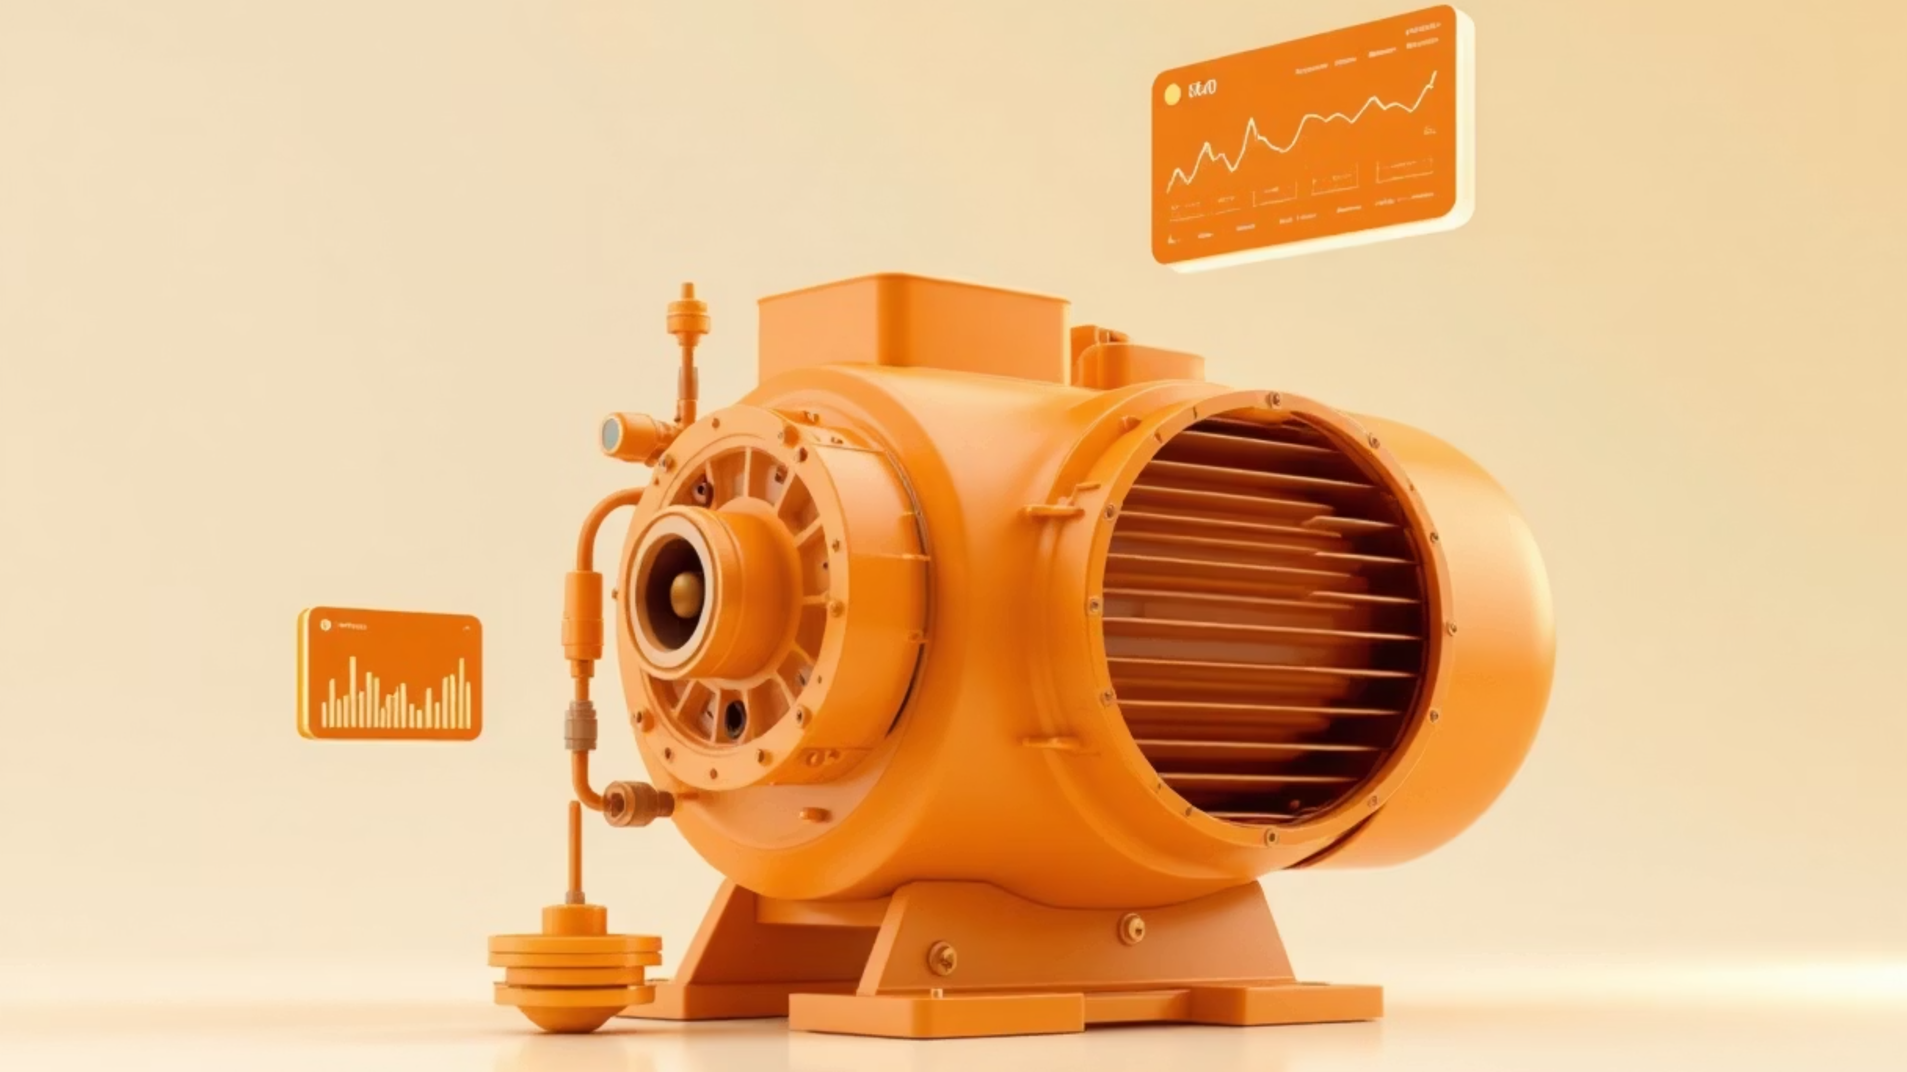
Predictive Maintenance of Induction Motors: An IoT & ML Approach
Induction motors are indispensable in industrial operations, yet unexpected failures result in substantial downtime and cost. This document details a low-cost, scalable Predictive Maintenance (PdM) system utilizing Internet of Things (IoT) sensors and Machine Learning (ML) to monitor motor health continuously. By analyzing real-time data on temperature, vibration, and voltage, the system shifts maintenance from reactive or time-based to data-driven and predictive, aligning with Industry 4.0 principles.

Slide 2
Introduction: Shifting from Reactive to Predictive Maintenance
Induction motors are the workhorses of industry, accounting for nearly 70% of motors in use. Their reliability is critical, but they remain susceptible to failures caused by bearing wear, overheating, and electrical issues. Unplanned motor failures lead directly to production halts, financial losses, and potential safety hazards.
The Problem with Traditional Maintenance
The Predictive Solution
Predictive Maintenance (Data-Driven): Leverages continuous condition monitoring via IoT sensors and advanced AI/ML algorithms to predict failures before they manifest, optimizing maintenance timing.
Preventive Maintenance (Scheduled): Often results in resource waste through unnecessary servicing or parts replacement, and still fails to anticipate sudden component failure.

Slide 3
Problem Statement & Project Objectives
The core challenge lies in the unpredictable nature of motor failures and the inefficiency of current maintenance strategies. This project addresses the lack of real-time, automated fault detection with a scalable solution.
Key Problems Addressed
Project Objectives
Unplanned motor failures causing costly downtime.
Preventive maintenance wasting resources and failing to prevent unexpected breakdowns.
Real-time Monitoring
1
Manual monitoring being time-consuming and prone to error.
Monitor temperature, vibration, and voltage continuously.
Lack of real-time fault diagnosis and forecasting.
Cloud Data Acquisition
2
Upload sensor data securely to Google Sheets for storage.
ML Anomaly Detection
3
Apply Machine Learning algorithms for fault prediction.
Visualization & Alerts
4
Develop a web dashboard for real-time visualization and maintenance alerts.

Slide 4
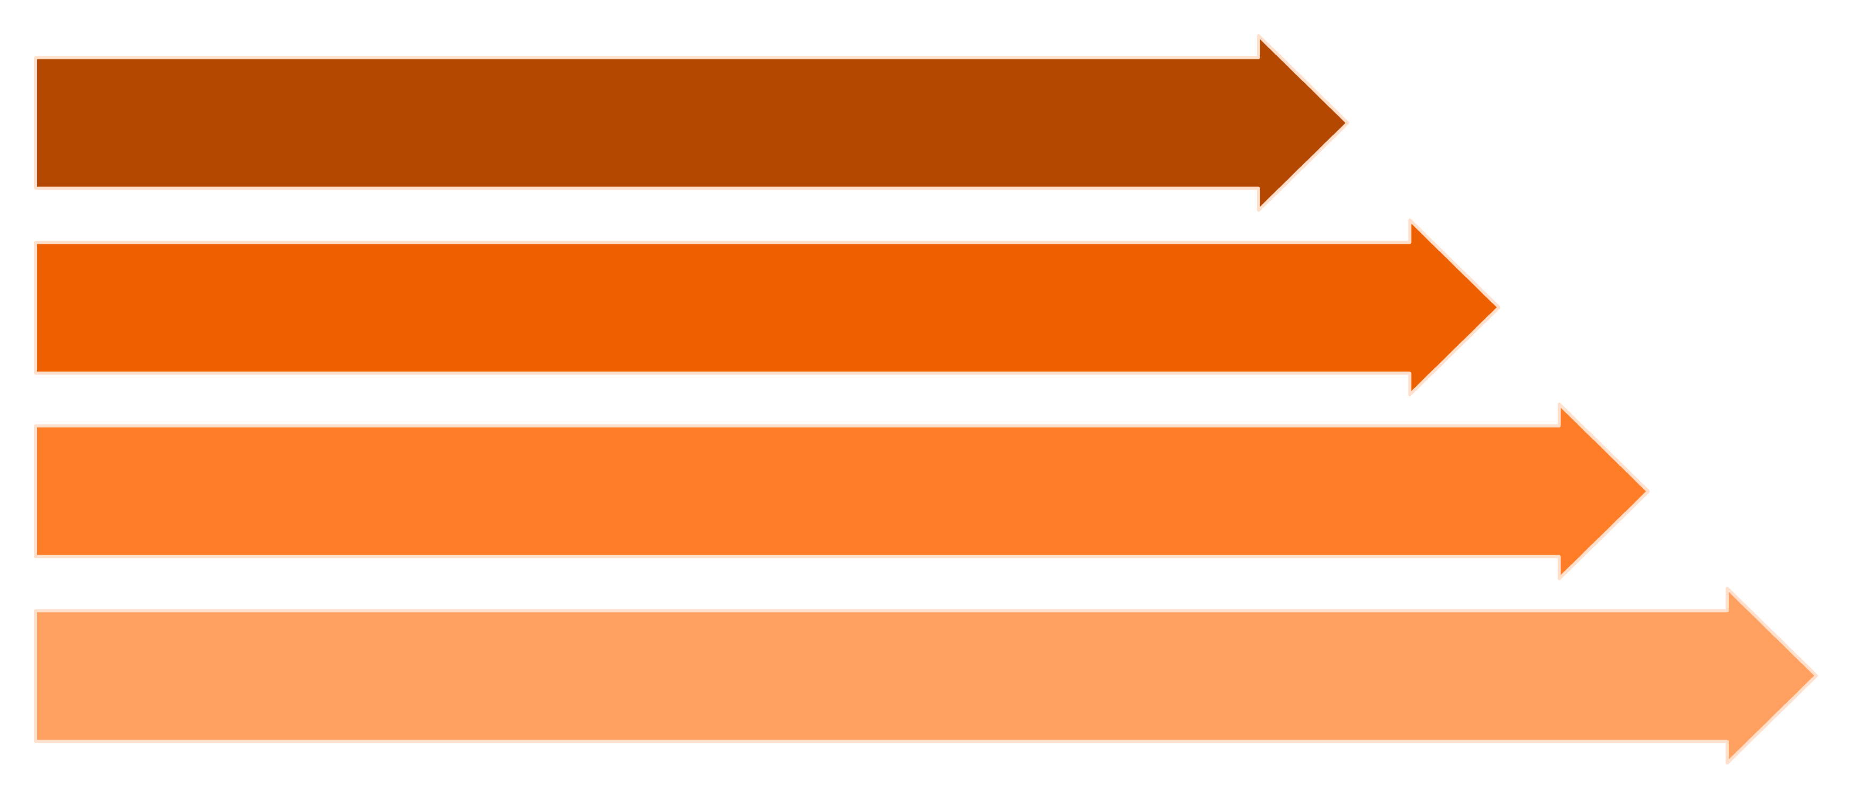
System Architecture and Data Flow
The system is divided into four main layers: Data Acquisition, IoT Processing, Cloud/Data Management, and Intelligence/Application. This layered approach ensures robust, scalable data handling and analysis.
Data Acquisition
IoT Processing
Data Logging
Intelligence & Application
The NodeMCU ESP8266 acts as the core gateway, collecting data from sensors (LM35/DS18B20 for Temperature, ADXL345 for Vibration, ZMPT101B for Voltage) and transmitting it via Wi-Fi to the cloud storage (Google Sheets). This cloud data then feeds the ML model for continuous prediction.

Slide 5
Component Selection and Sensor Specifications
Choosing the right sensors is fundamental for effective condition monitoring. We selected low-cost components that provide reliable data for identifying key motor fault indicators: thermal stress, mechanical issues, and electrical supply quality.
Sensor/Component
Parameter Measured
Typical Range / Function
Motor Application Indicator
LM35 / DS18B20
Temperature
-55°C to 150°C
Detects overheating due to friction or electrical faults.
ADXL345
Vibration (Accel.)
±16g
Indicates mechanical faults like bearing wear, imbalance, or misalignment.
ZMPT101B
Voltage
0–250V AC
Monitors power quality, detecting undervoltage or overvoltage issues.
ESP8266
Microcontroller
Wi-Fi, ADC, UART
Data acquisition, processing, and cloud upload gateway.

Slide 6


Data Logging and Machine Learning Integration
The continuous stream of data requires robust processing and storage before it can be leveraged by the ML model. The data log serves as the foundation for both training the model and making real-time predictions.
ML Workflow: From Data to Prediction
Feature Extraction
Calculate statistical features (e.g., RMS vibration, average temperature, voltage fluctuation) from raw data.
Model Training
Train an ML algorithm (e.g., Random Forest or SVM) using historical data tagged with 'Normal' vs. 'Faulty' conditions.
Real-time Inference
Trained model receives new sensor data, classifies motor status, and forecasts potential failure time.
The use of Google Sheets allows for rapid prototyping and easy data accessibility. For industrial scale, a dedicated time-series database (e.g., InfluxDB) or a major cloud platform would be required for performance.

Slide 7
Sample Dataset and Maintenance Strategy Comparison
Predictive maintenance allows for intervention at the critical 'Warning' stage, preventing the transition to 'Faulty' operation and subsequent failure.
Sample Motor Dataset
Time
Temp (°C)
Vibration (m/s²)
Voltage (V)
Status
10:00
55
0.3
220
Normal
10:05
65
0.8
225
Warning
10:10
85
1.5
230
Faulty
Maintenance Strategy Comparison
Preventive Maintenance
Approach: Scheduled inspections/replacement.
Cost: Higher (unnecessary parts).
Reliability: Moderate (potential for unexpected failure remains).
Predictive Maintenance (PdM)
Approach: Real-time monitoring & ML prediction.
Cost: Optimized (maintenance only when required).
Reliability: High (early fault detection and reduced downtime).

Slide 8





System Advantages and Limitations
The prototype delivers significant operational benefits but also faces practical constraints inherent to its low-cost design and deployment environment.
5.1 Advantages
5.2 Disadvantages
Requires stable Wi-Fi/internet connectivity for continuous data upload.
ML model accuracy is directly dependent on the quality and volume of training data (Normal vs. Fault conditions).
Early Fault Prediction
Google Sheets API is not designed for the high throughput requirements of large-scale industrial data logging.
Significantly reduces costly unplanned downtime by enabling proactive repairs.
Sensors and acquisition units require routine calibration and maintenance in harsh industrial settings.
Cost-Effective & Scalable
Utilizes low-cost, off-the-shelf components suitable for small to mid-sized industrial environments.
Remote Accessibility
Cloud-based data storage and dashboard allow remote monitoring and alert access.
Extended Motor Lifespan
Minimizes operational stress and failure risk, prolonging equipment life.

Slide 9





Applications and Future Scope
This Predictive Maintenance solution is highly applicable across various sectors and serves as a foundational prototype for more sophisticated future developments.
Industry 4.0 Applications
Future Scope for Expansion
Manufacturing industries (e.g., assembly lines, pumps, conveyors).
Integrate with commercial cloud platforms (AWS IoT, Azure, ThingSpeak) for scalability.
Power generation plants and HVAC systems.
Smart factories and process control environments.
Adopt Deep Learning (DL) models for improved fault classification and diagnosis.
Implement wireless sensor networks for monitoring multiple motors simultaneously.

Slide 10


Conclusion: Proving the Potential of IoT and ML in PdM
The prototype successfully demonstrates a functional, low-cost Predictive Maintenance System for induction motors. By leveraging the power of IoT for real-time data acquisition and Machine Learning for intelligent analysis, it transitions maintenance practices from reactive to proactive.
The integration of sensor data (temperature, vibration, voltage) with cloud storage and ML analysis creates a robust framework for early fault detection. This system reduces operational risk, minimizes downtime, and optimizes maintenance schedules, affirming its role as a key enabler for efficient Industry 4.0 operations.
Reduced Downtime
Optimized Costs
Industry 4.0 Alignment
Enables scheduling maintenance before critical failure.
Eliminates unnecessary preventive servicing and minimizes repair costs.
A crucial step toward smart, automated industrial systems.
Keywords: Induction Motor, Predictive Maintenance, Machine Learning, IoT, Google Sheets, Condition Monitoring, Vibration Analysis

