Slide 1
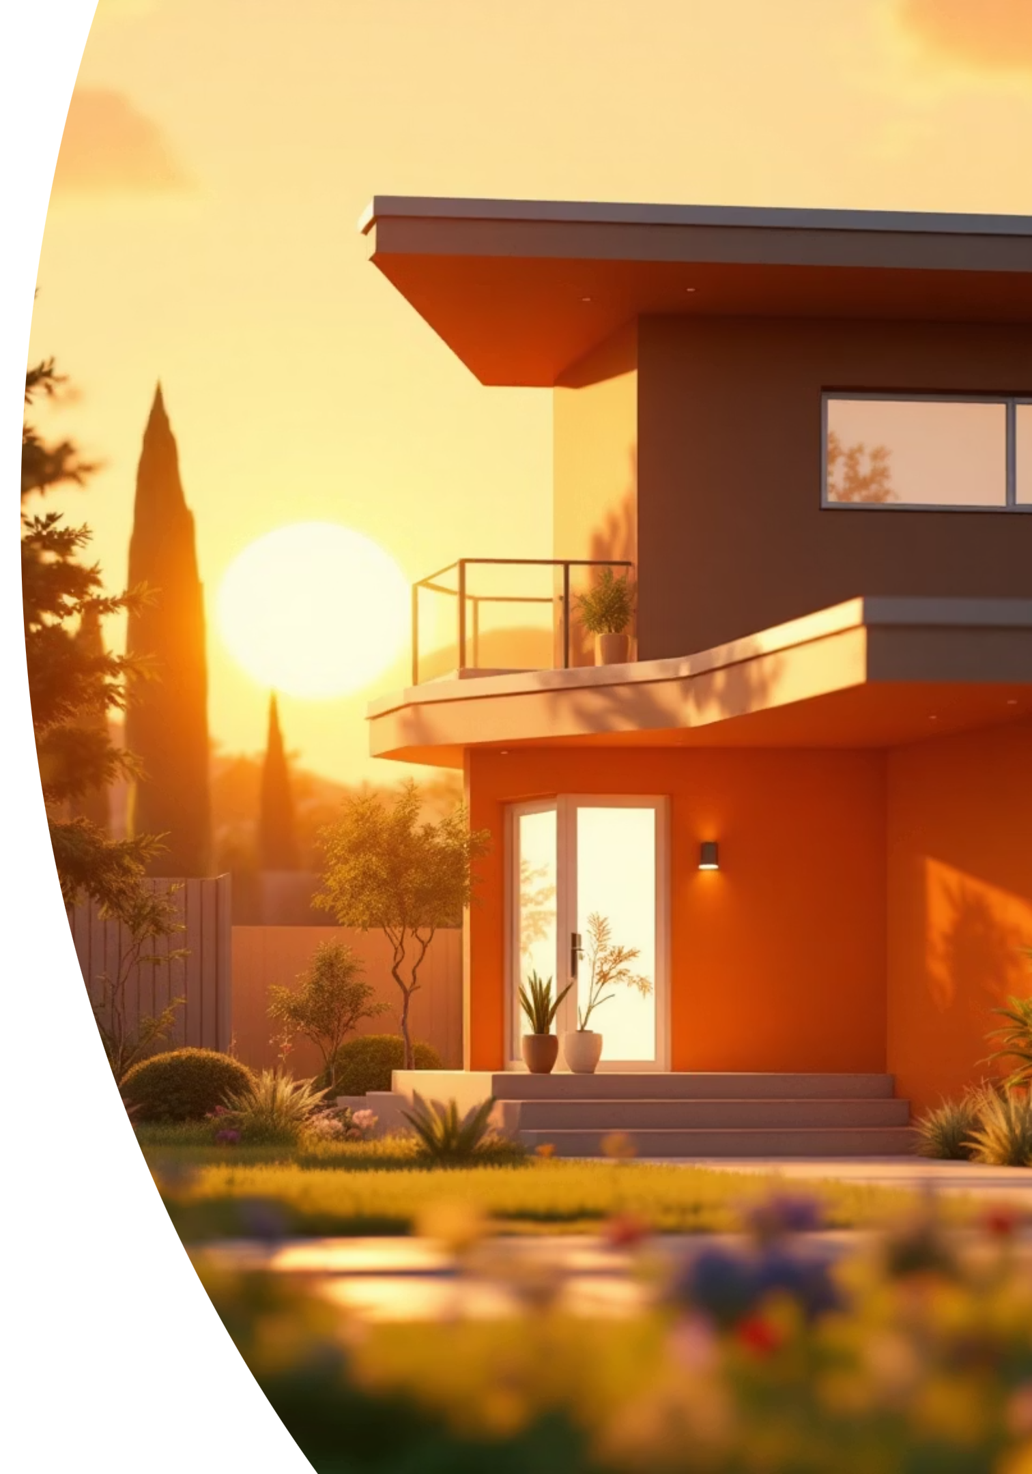
Home Security System using IoT & Machine Learning
Presented by: [Your Name]
Institution/Organization: [XYZ]

Slide 2




EXECUTIVE SUMMARY
Intelligent Home Security: The Fusion of IoT and ML
Critical Concern
Enhanced Monitoring
Traditional security methods are often limited to manual monitoring or fixed, reactive alarms.
IoT cameras and sensors provide continuous, real-time environmental monitoring.
Smart Detection
Real-Time Action
ML algorithms analyze streams of video and sensor data to predict and detect unusual activity and potential threats proactively.
Homeowners receive instant, actionable alerts via a centralized dashboard and mobile application for peace of mind.

Slide 3


THE NEED FOR SMART SECURITY
Addressing the Limitations of Conventional Alarms
Rising incidents of burglary, intrusion, and vandalism in both urban and rural settings underscore the need for advanced protection. Manual monitoring is inherently inefficient, labor-intensive, and prone to human error.
This solution leverages IoT and Machine Learning to deliver an automated, intelligent security ecosystem offering continuous surveillance, predictive detection, and instant, verified alerts.
Problem Statement
Conventional alarm systems are fundamentally reactive, only responding after a triggered event. They lack the ability for intelligent, preventative threat detection and real-time monitoring when the homeowner is absent.

Slide 4
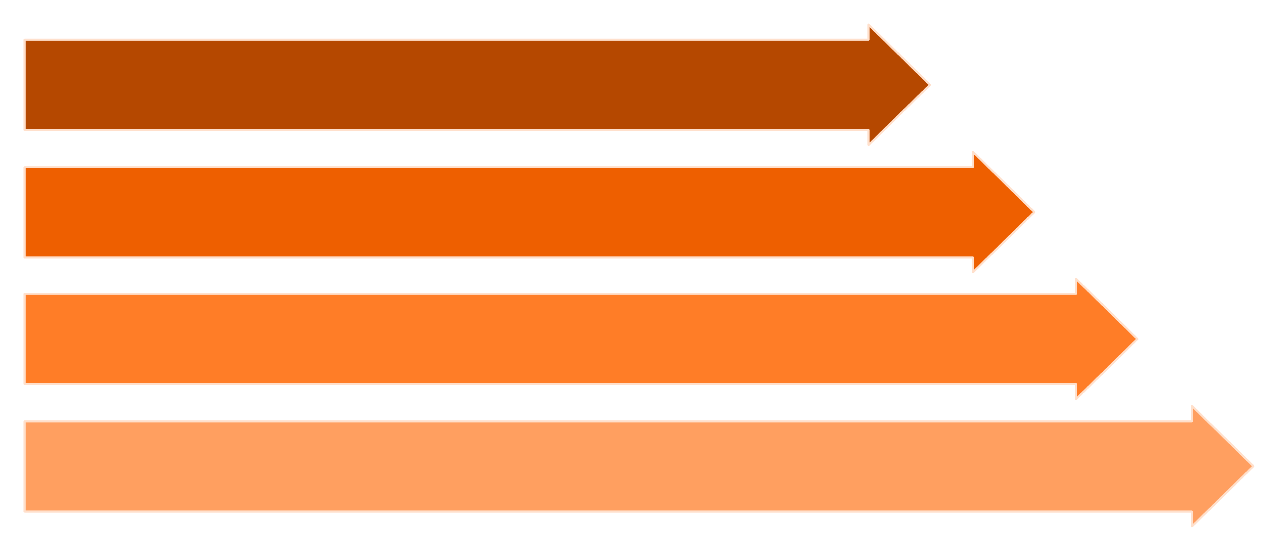
SYSTEM ARCHITECTURE
Data Flow from Edge to Cloud
Edge Sensors
IoT Node
Cloud DB
ML & Alerts
The system design is modular, ensuring reliability and scalability. Data is collected at the edge, processed locally, and then transferred to the cloud for sophisticated Machine Learning analysis and alert generation.

Slide 5




KEY OBJECTIVES AND HARDWARE
Operationalizing the Security Solution
Core System Objectives
Essential Hardware Components
Deploy robust IoT sensors and high-definition cameras in strategic home areas.
Collect, transmit, and securely store real-time environmental and visual data in the cloud.
PIR Motion Sensors
Apply advanced ML algorithms to detect, classify, and predict potential security threats.
Instantly notify homeowners of verified threats via a dedicated mobile application and dashboard.
Provide a comprehensive, actionable platform for security monitoring and review.
IoT Cameras (Video)
Door/Window Sensors
Processing Node (ESP32/RPi)
Optional components include sirens, integrated smart locks, and backup power solutions (solar/battery).

Slide 6




SOFTWARE & DEVELOPMENT STACK
Tools Driving Intelligence and Connectivity
Edge Programming
Data Storage & Cloud
Microcontroller firmware written in Arduino IDE or MicroPython for efficient data collection and initial processing on the IoT Node.
Scalable cloud infrastructure (Firebase, AWS, or Google Sheets) is used for secure real-time data ingestion and storage.
ML Frameworks
User Interface
Computer vision libraries (OpenCV) and deep learning frameworks (TensorFlow, Keras) for complex video and sensor analysis.
Web dashboard (Flask/Django) and cross-platform mobile app (React Native/Flutter) for real-time visualization and alerts.

Slide 7
METHODOLOGY
The Six-Step Data-to-Action Pipeline
01
02
Data Acquisition
IoT Node Processing
Sensors (motion, door/window) and cameras capture raw data streams: environmental status and video frames.
The ESP32/RPi collects, filters, and encodes data packets and video frames for transmission efficiency.
03
04
Cloud Upload
Preprocessing & Validation
Processed data is securely transmitted and stored in the cloud for centralized storage and Machine Learning computation.
Cloud functions clean sensor data and format video frames, ensuring optimal input for the ML models.
05
06
ML Analysis
Dashboard & Alerts
Algorithms perform object detection, anomaly detection, and classification to identify potential threats.
Real-time threat status is displayed, and immediate push notifications are sent to the homeowner.

Slide 8




INTELLIGENT DETECTION
Machine Learning for Threat Classification
Convolutional Neural Networks (CNN)
Object Detection (YOLO/SSD)
Used for deep analysis of video frames to extract features relevant for recognizing objects and scenes.
Enables real-time identification and localization of potential intruders (e.g., human vs. animal) within the video feed.
Anomaly Detection
Facial Recognition
Identifies deviations from baseline 'normal' activities, providing early warning for unusual behavior or events.
Distinguishes authorized residents from unknown or unauthorized persons, significantly reducing false positives.

Slide 9

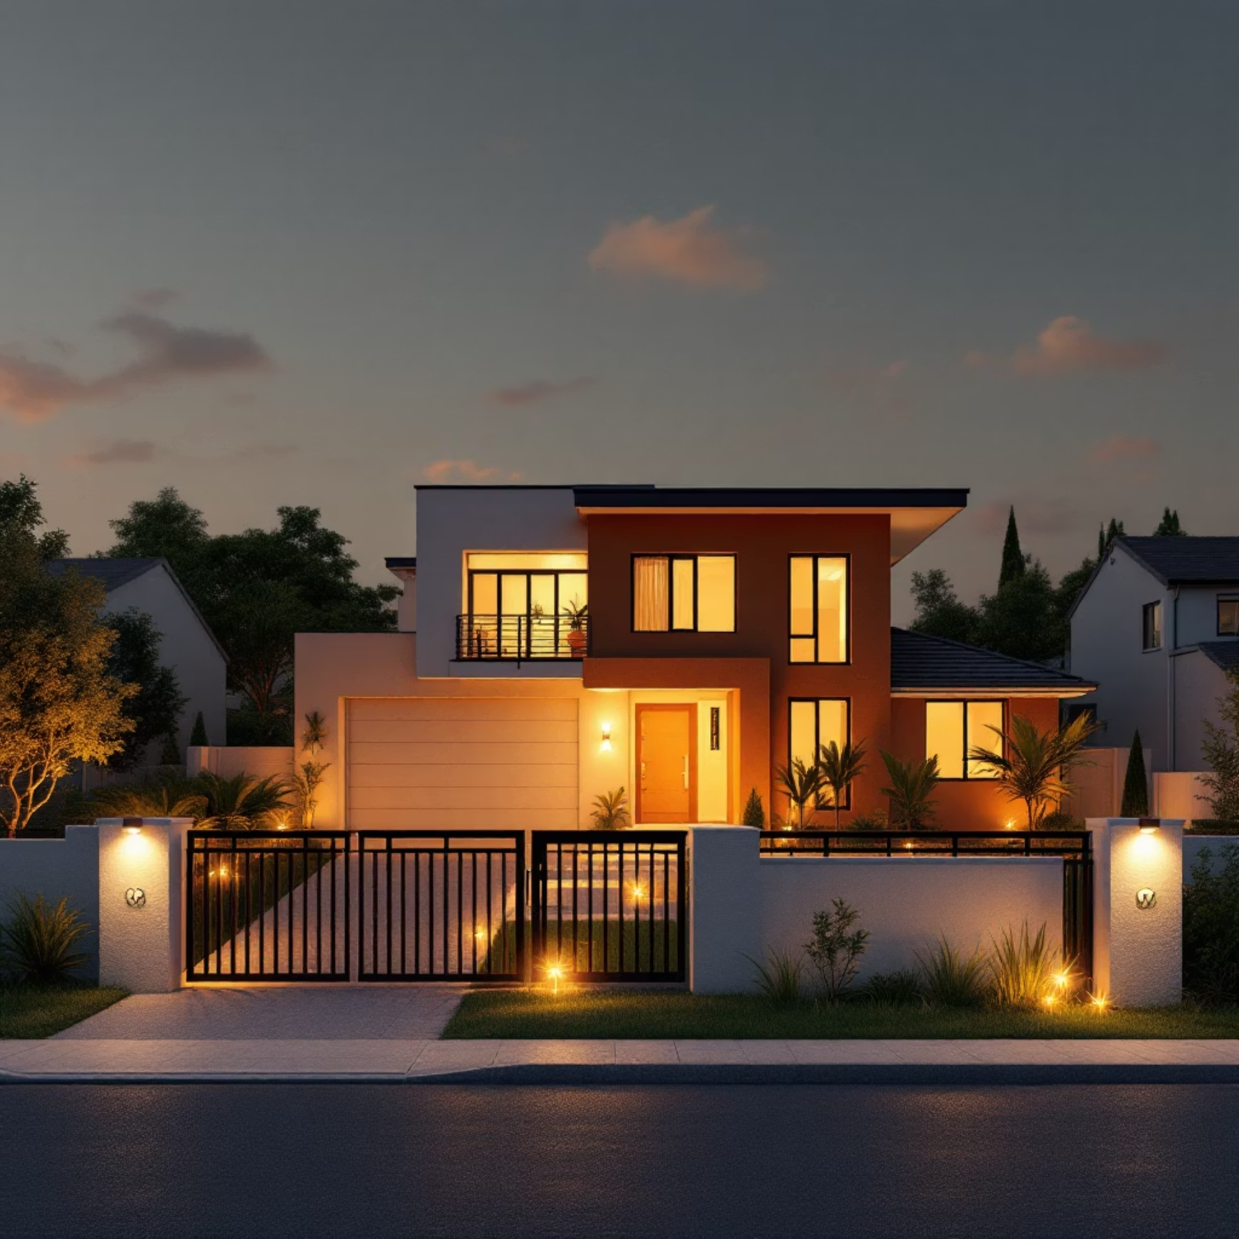
APPLICATIONS & ADVANTAGES
The Value Proposition of Smart Security
Primary Applications
Key Advantages
Residential homes requiring 24/7 intelligent monitoring.
Proactive Detection: Real-time identification and prediction of threats, not just reaction.
Apartments and gated communities seeking centralized security management.
Small businesses and offices needing automated surveillance and access control.
Integration into comprehensive smart home and IoT ecosystems.
Remote Monitoring: Continuous access and oversight via mobile device, regardless of location.
Reduced False Alarms: Intelligent ML analysis validates threats before triggering an alert.
System Integration: Seamless interoperability with other smart home devices and services.

Slide 10

CONCLUSION AND FUTURE OUTLOOK
Towards Predictive, AI-Driven Protection
Current Limitations
Future Scope: Next-Generation Security
System reliability is highly dependent on a stable internet connection for cloud functions.
AI-Based Predictive Security
High initial cost of acquiring and installing multiple IoT devices and cameras.
Implementing advanced AI for analyzing behavioral patterns to predict and prevent security breaches before they occur.
ML model accuracy must be continuously trained and fine-tuned for varying environmental conditions.
Edge Computing Integration
Shifting critical ML analysis to local processing nodes (RPi) to ensure faster response times and reliable offline operation.
Autonomous Surveillance
Exploring the use of integrated drone or robot systems for dynamic, large-area home surveillance.
The integration of IoT and ML provides a scalable, intelligent, and proactive security system essential for the modern smart home environment.

